Slide 1
Sorting and selection
School of Artificial Intelligence

Slide 2
Previously on DS&A
Sorting algorithms
Insertion-sort
Selection-sort
Bubble-sort
Heap-sort
Merge-sort
Quick-sort

Slide 3
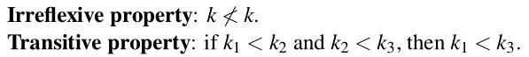
This lecture
Sorting algorithms
Rearrange a collection of elements so that they are ordered from smallest to largest
Such an order exists in Python: the < operator
Most important and well studied computing problem
Data sets are often stored in sorted order to allow for efficient searches
E.g. binary search algorithm
Python: built-in support for sorting data
sort()

Slide 4
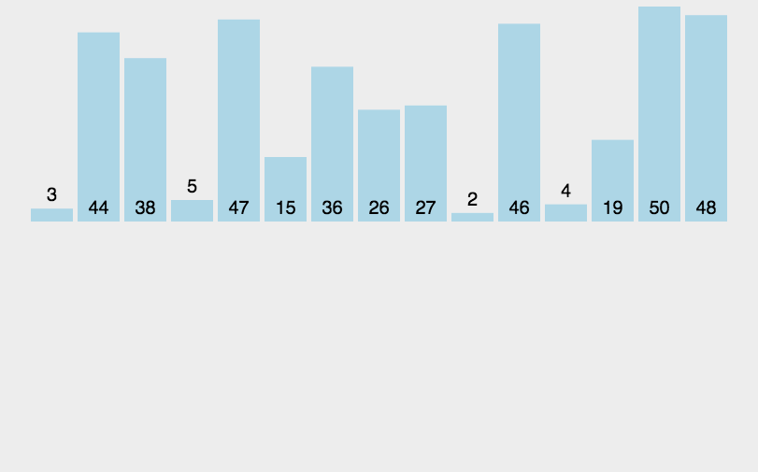
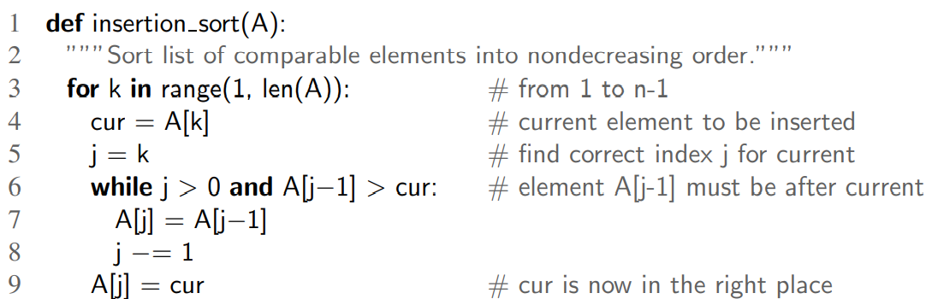
Insertion Sort
Insertion sort

Slide 5
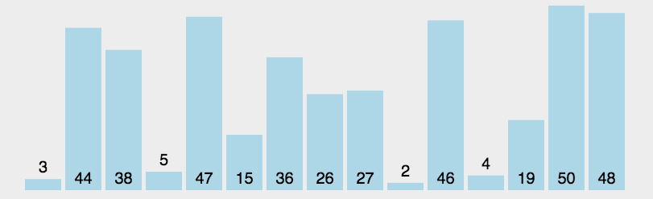
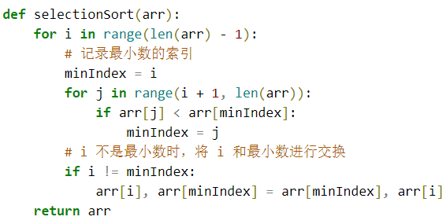
Selection Sort
Selection sort
We have seen this
In Priority Queue

Slide 6
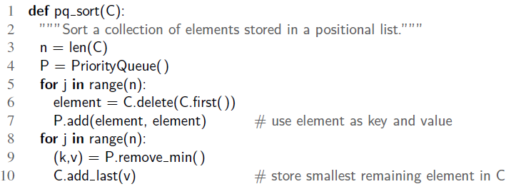
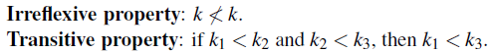
Sorting with a priority queue
Priority queue ADT: any type of object can be used as a key, as long as they can be compared with the comparison operator <
Comparison operators need to be irreflexive and transitive
Use priority queue to sort a collection C of comparable elements.
Insert all elements into an empty priority queue, and call remove_min to get an increasing order

Slide 7
Sorting with a priority queue
pq_sort(): works OK, but its complexity?
Depends on add() and remove_min()
Selection-Sort: implement P with an unsorted list
add() takes O(n) time in total since it is O(1) for add()
remove_min(): selecting element to dequeue()
Total running time: O(n + (n-1) + (n-2) + … + 1) = O(n²)
Insertion-Sort: implement P with a sorted list
remove_min() takes O(n) time in total since it is O(1) for each remove_min()
add(): finding the proper place to add takes O(n²) time in total

Slide 8
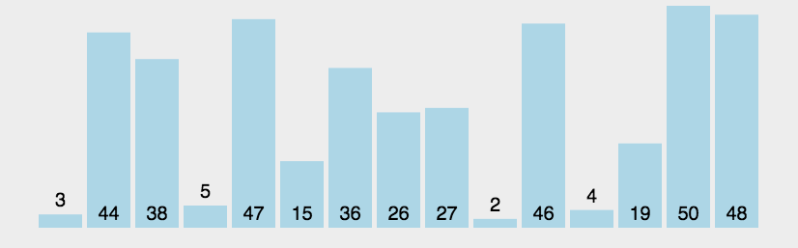
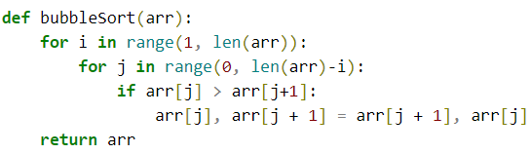
Bubble sort
Bubble sort

Slide 9
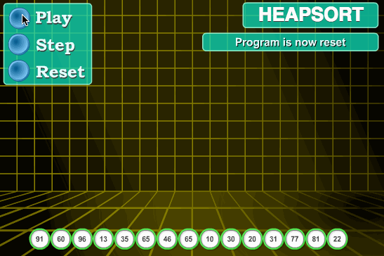
Heap sort
Heap sort

Slide 10
HEAP（堆）
Heap: a binary tree that stores a collection of items at its positions
A relational property defined in terms of the way keys are stored in T
A structural property defined in terms of the shape of T itself
Relational property (heap order property): In a heap T, for every position p other than the root, the key stored at p is greater than or equal to the key stored at p’s parent
Structural property (complete binary tree property): A heap T with height h is a complete binary tree if levels 0, 1, 2, …, h-1 of T have the maximum number of nodes possible (level i has 2^{i} nodes, for 0<= i <= h-1) and the remaining nodes at level h reside in the lfeftmost possible positions at that level

Slide 11
Heap sort
Implementing in-place heap-sort （原地堆排序）
Need to modify the algorithm
Maximum-oriented heap: each position’s key being at least as large as its children. At any time during the execution, use the left portion of C, up to a certain index i-1, to store the entries of the heap, and the right portion of C, from i to n-1, to store the elements of the sequence
In the first phase of the algorithm, start with an empty heap and move the boundary between the heap and the sequence from left to right, one step at a time.
In the second phase of the algorithm, we start with an empty sequence and move the boundary between the heap and the sequence from right to left, one step at a time.

Slide 12
Merge Sort
Divide and conquer
Divide: if the input size is smaller than a certain threshold, solve the problem directly. Otherwise, divide the input data into two or more disjoint subsets
Conquer: recursively solve the sub-problems associated with the subsets
Combine: take the solutions to the sub-problems and merge them into a solution to the original problem

Slide 13
Merge Sort
Divide and conquer for sorting
Divide: if S has zero or one element, return S. Otherwise, remove all the elements from S and put them into two sequences, S1 and S2, each containing half of the elements of S
Conquer: recursively sort sequence S1 and S2
Combine: put back the elements into S by merging the sorted sequences S1 and S2 into a sorted sequence

Slide 14
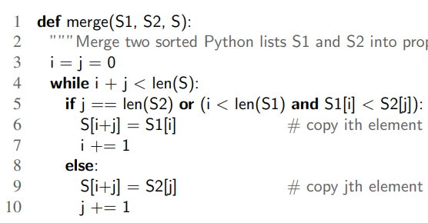
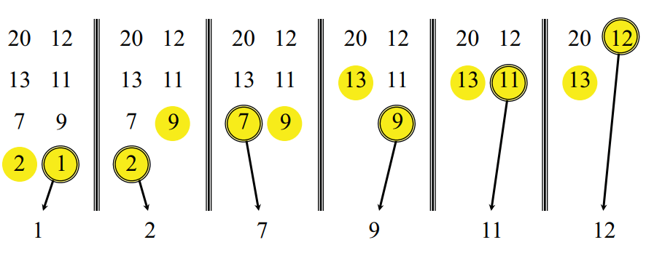
Merge Sort
Merge sort

Slide 15
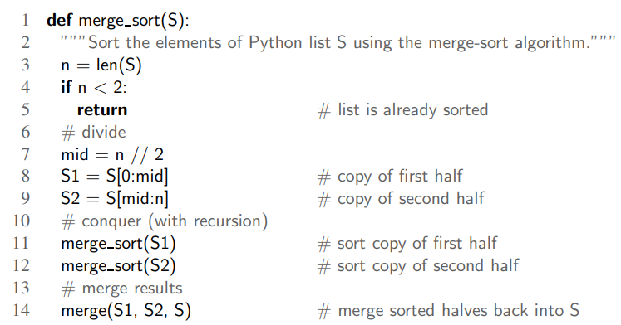
Merge Sort
Merge sort

Slide 16
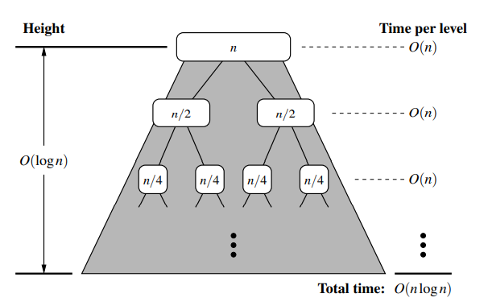
Merge sort
merge_sort(A[1..n])
If n = 1, done
recursively sort A[1..n//2], A[n//2+1..n]
Merge the two sorted list
Notes:
Index 0

Slide 17
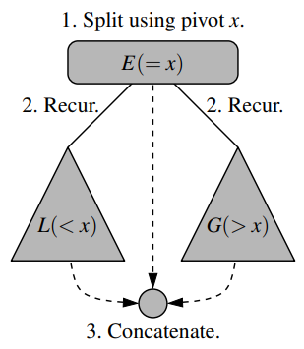
Quick Sort
Divide: if S has at least two elements, select a specific element x from S, which is called the pivot(枢纽). The common practice is to choose the last element of S. Remove all the elements from S and put them into three sequences:
L, storing elements in S less than x
E, storing elements in S equal to x
G, storing elements in S greater than x
Conquer: recursively sort sequences L and G
Combine: Put back the elements into S in order by first inserting the elements of L, then E, then G
Notes:
Index 0

Slide 18
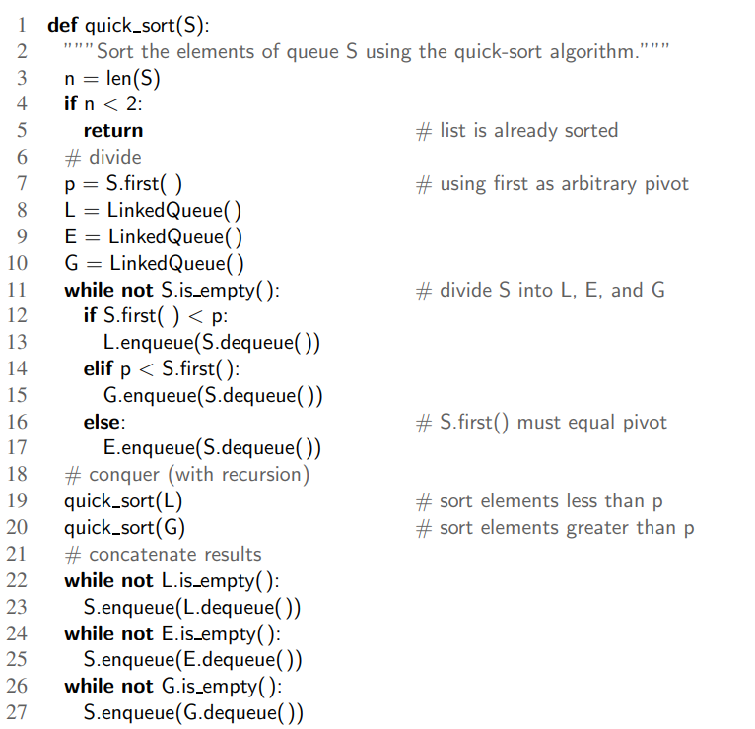
Quick Sort
Height of the quick-sort tree: linear in the worst case
Why?
For an already-sorted sequence of n elements
Height = n-1
Running time:
Worst case: O(n²)
Best case: O(n log n)
Selection of Pivot: last element of S
Improved selection method: pick Pivot at random in S
Expected running time: O(n log n)
Notes:
Index 0

Slide 19
Sorting
O(n log n) algorithms: merge sort, quick sort and heap-sort
Can algorithms do better than O(n log n)?
Comparison model:
All input items are black boxes
Only operations allowed are comparisons (<, <=, >, >=, ==)
Time cost = #comparisons
Prove: O(log n) time to search and O(n log n) time to sort
Notes:
Index 0

Slide 20
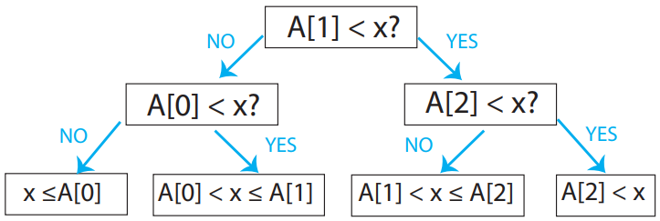
Decision tree
Decision tree: any comparison algorithm can be viewed as a tree of
all possible comparisons
their outcomes, and
Their resulting answer
For any particular n (size of problem)
Binary search for n = 3
Internal node: binary decision
Leaf: output (algorithm is done)
Root-to-leaf: algorithm execution
Depth: running time
Height of tree: worst-case running time

Slide 21
Search lower bound
N preprocessed items
Finding a given item among them in comparison model requires Ω(log n) in worst case
Why?
Decision tree is binary, and therefore must have at least n leaves for each answer
Height >= log n

Slide 22
Sorting lower bound
N preprocessed items
Finding a given item among them in comparison model requires Ω(n log n) in worst case
Why?
Decision tree is binary
# leaves >= # possible answers
Possible answers?
n!

Slide 23
Linear time sorting
Sorting: Ω(n log n) worst case to sort an n-element sequence with comparison based sorting algorithm
Are there any algorithms that run asymptotically faster than O(n log n) time?
Yes
But there are special assumptions about the input sequence
Assumption:
Keys to be sorted are integers
Keys are in range [0, N-1] where N >= 2
Keys fit in a word (supported by your computer)
For k not too big, can sort in O(n) time
Otherwise: O(n*sqrt(log log n))

Slide 24
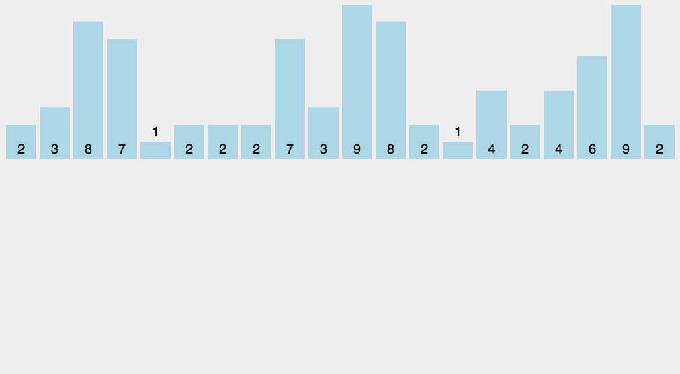
Linear time sorting
Counting sort
L = array of k empty lists
For j in range n:
L[key(A[j])].append(A[j])
Output = []
For i in range k:
Output.extend(L[i])
Time: O(n + k)
Count key occurrences using RAM output <count> copies of each key in order
But item is more than just a key

Slide 25
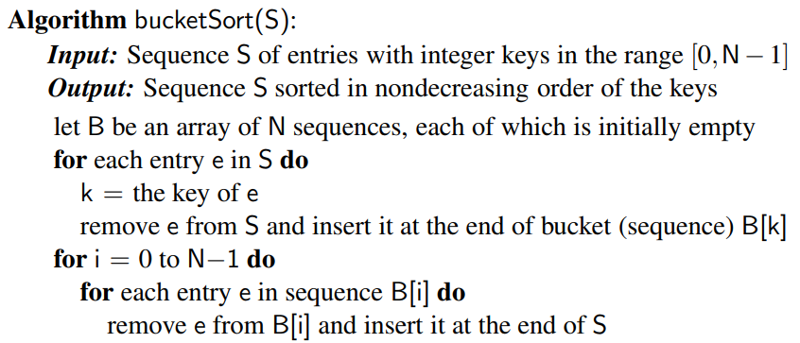
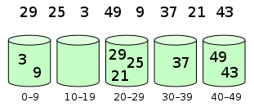
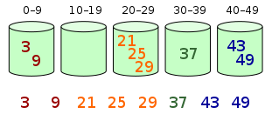
Linear time sorting
Bucket sort
Sequence S of n entries
Keys are integers in [0, N-1], N>=2
It is possible to sort S in O(n+N)
O(n) if N is O(n)

Slide 26
Linear time sorting
Radix sort
Stable sorting
S = ((k0, v0), …, (kn-1, vn-1))
A sorting algorithm is stable if any two entries (ki, vi) and (kj, vj) of S
When ki = kj and (ki, vi) precedes (kj, vj) before sorting
(ki, vi) precedes (kj, vj) after sorting

Slide 27
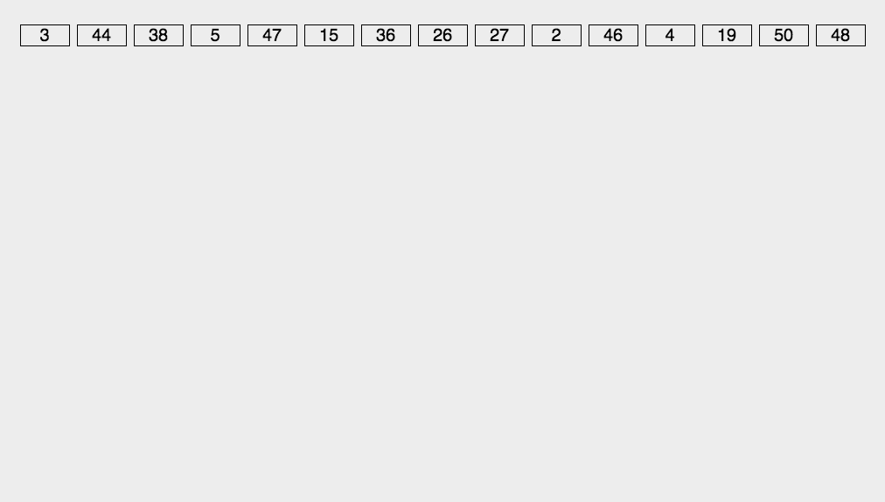
Linear time sorting
Radix sort
Imagine each integer as base b
# digits = d = log_{b}k + 1
Sort integers by least significant digit
…
Sort by most significant digit
Sort using counting sort
Each iteration: O(n + b)
Total: O((n+b)*d)
= O((n+b)*log_{b} k)
When b = Θ(n)
O(n*log_{n} k)
If k = n^{c} then O(nc)

Slide 28
Sorting algorithms
O(n²) algorithms
Selection sort, insertion sort
O(n log n) algorithms
Heap sort, merge sort, quick sort
Linear time algorithms
Counting sort, bucket sort, radix sort
Poorest choice of algorithms?
Selection sort
Best case O(n²)

Slide 29
Sorting algorithms
Insertion sort
O(n + m), where m is number of inversions
Good when n is small
Good when m is small
O(n²) when m is large and n is large
Heap sort
O(n log n) time worst case
In-place easy to implement
Slower than quick sort and merge sort on larger sequences

Slide 30
Sorting algorithms
Quick sort
Worst case O(n²)
O (n log n) expected
Faster than heap sort and merge sort on may tests
Can be implemented in-place
Merge sort
O(n log n) worst case
In-place implementation: difficult
Hence slower than quick sort
Bucket sort and radix sort
Limitations: small integer keys, character strings, d-tuples from a discrete range
O(d(n+N) time, in range [0, N-1]

Slide 31
Built-in sorting in Python
Sort(): sort a collection of items
N.B. the items need to be comparable, how do you do this?
Sorted(): return a copy of the collection in sorted order, original collection unchanged
What if you want to sort a collection based on your notion of order?
E.g. sort by the length of a string?

Slide 32
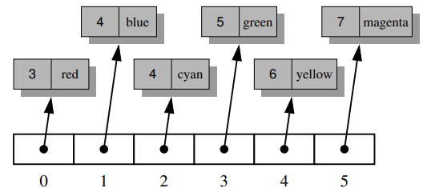
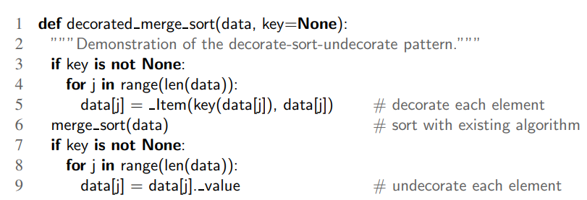
Built-in sorting in Python
Decorate-sort-undecorate
each element be replaced by a ‘decorated’ version that includes the result of the key function applied to the element
Collection is sorted based on the order of the keys
Decorated elements are replaced by the original elements

Slide 33
selection
Identifying a single element in terms of its rank relative to the sorted order of the entire collection
E.g. median, percentile
Selection problem
General order-statistic problem
Selecting the k^{th} smallest element from an unsorted collection of n comparable elements
Approach
Sorting the collection: O(n log n)
What if k = 1, or k = n?
That requires only O(n) time
Question: achieve an O(n) time for all values of k

Slide 34
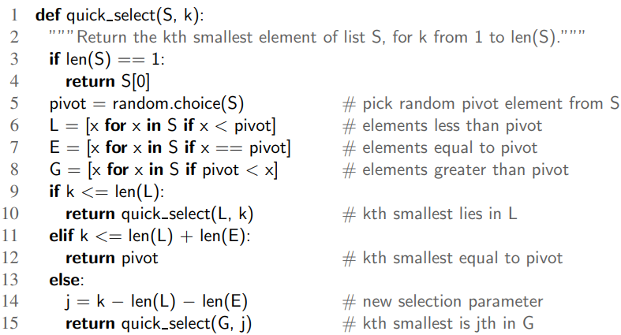
selection
Prune and search
Prune away a fraction of the n objects
Solve the smaller problem recursively
Problem size -> defined constant-sized collection of objects
Apply brute-force
Binary search: “prune” by comparison
Randomised quick-select
O(n) expected time
O(n²) worst case

Slide 35
Thanks
See you in the next session!

